Slide 1
Machine Learning Essentials: Decode the Basics of ML
Mac AI

Slide 2
Brief Introduction
My name is Connor
Computer Engineering III
Director of Education

Slide 3
Brief Introduction
My name is Vraj
Computer Engineering II
Education Coordinator / Workshop Developer

Slide 4
Workshop Overview
ML Overview
Supervised Learning Theory
Building a Simple Model demo
KAHOOT
Feedback

Slide 5
What is the Purpose of ML
At its simplest, ML is pattern matching for function arguments
Given some input X it needs to accurately predict F(X)
Through accurate representation of the function, there are many possible implications/ use cases:
Virtual Assistants
Machine Vision (Object Detection/ Image Recognition)
Pattern Replication in Art
Market Prediction in Finance
Etc.
Notes:
Key take away is that that ML is able to abstract the body of a function in a unique way, and using this custom function, many complex problems can be tackled in ways they could have been approached before

Slide 6
What is Machine Learning
Essentially math equations
Due to the use of many ML frameworks, we do not have to know how to implement low level algorithms to start a project
Despite that, an understanding of a few key algorithms will be important in completing projects
Notes:
Definition: Machine learning is a field of artificial intelligence that uses statistical techniques to give computer systems the ability to "learn" from data, without being explicitly programmed

Slide 7

How does a "Machine" Learn?
Supervised Learning
Trains the model from labelling training data
Allows to predict output for future or unseen data
Unsupervised Learning
Trains the model on data which isn't classified
How exactly does it predict data then?
Notes:
Answer to Question: It tries to patterns and similar characteristics and begins to group the data together (known as clustering)

Slide 8
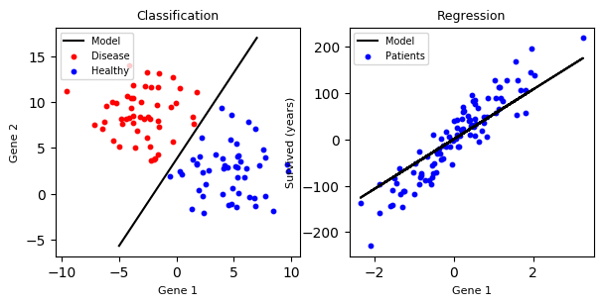
Different Types?
Classification
Regression
Output contains pre-defined labels which have discrete values
Output has continuous value which isn't restricted to defined discrete values
Notes:
Within Supervised Learning, there are 2 main types, Classification and Regression - (explain what is on slides (Regression usually deals with numbers, and classification tends to deal with Labels as shown in the graph))
Talk about how the graphs differ from each other (Classificatoin groups the data into separate groups, Regression forms a linear pattern between the data also known as linear regression)

Slide 9

Decision Trees
Supervised Learning Algorithm which can be used for either Regression or Classification, similar to if statement
Can be used for something simple as predicting weather (sunny, rainy, cloudy, etc.)
Real World Applications where Decision Trees are used:
Finance (Credit Scoring)
Medicine (Disease Diagnosis)

Slide 10
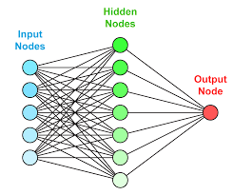
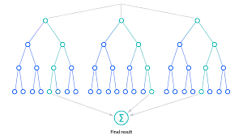
Random Forest
Produces multiple decision trees (structured the same as a condition statement)
Can be used in either, Regression or Classification Learning Methods
Also used in Finance and AI models which detect Spam/Phishing emails
Notes:
Random Forest is a type of algorithm and it is very versatile (talk about the slide content), mention on how it also looks very similar to a neural network
This lecture had a lot of theory and we realize that, so we are going to give you a quick demo

Slide 11
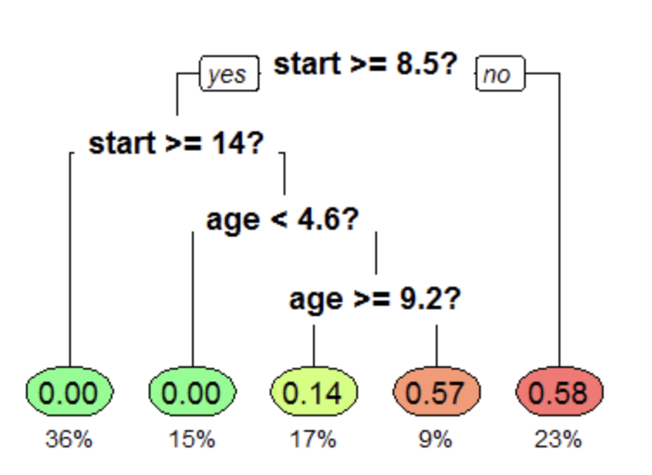
Notes:
This is the Decision Tree Diagram we will be using for the demo

Slide 12
Kahoot
https://create.kahoot.it/details/b2dff570-fc7c-48d0-b34a-f5dbccaad77e

Slide 13
Resources
https://www.analyticsvidhya.com/blog/2019/08/11-important-model-evaluation-error-metrics/ - Blog post for Evaluation Metrics

Slide 14
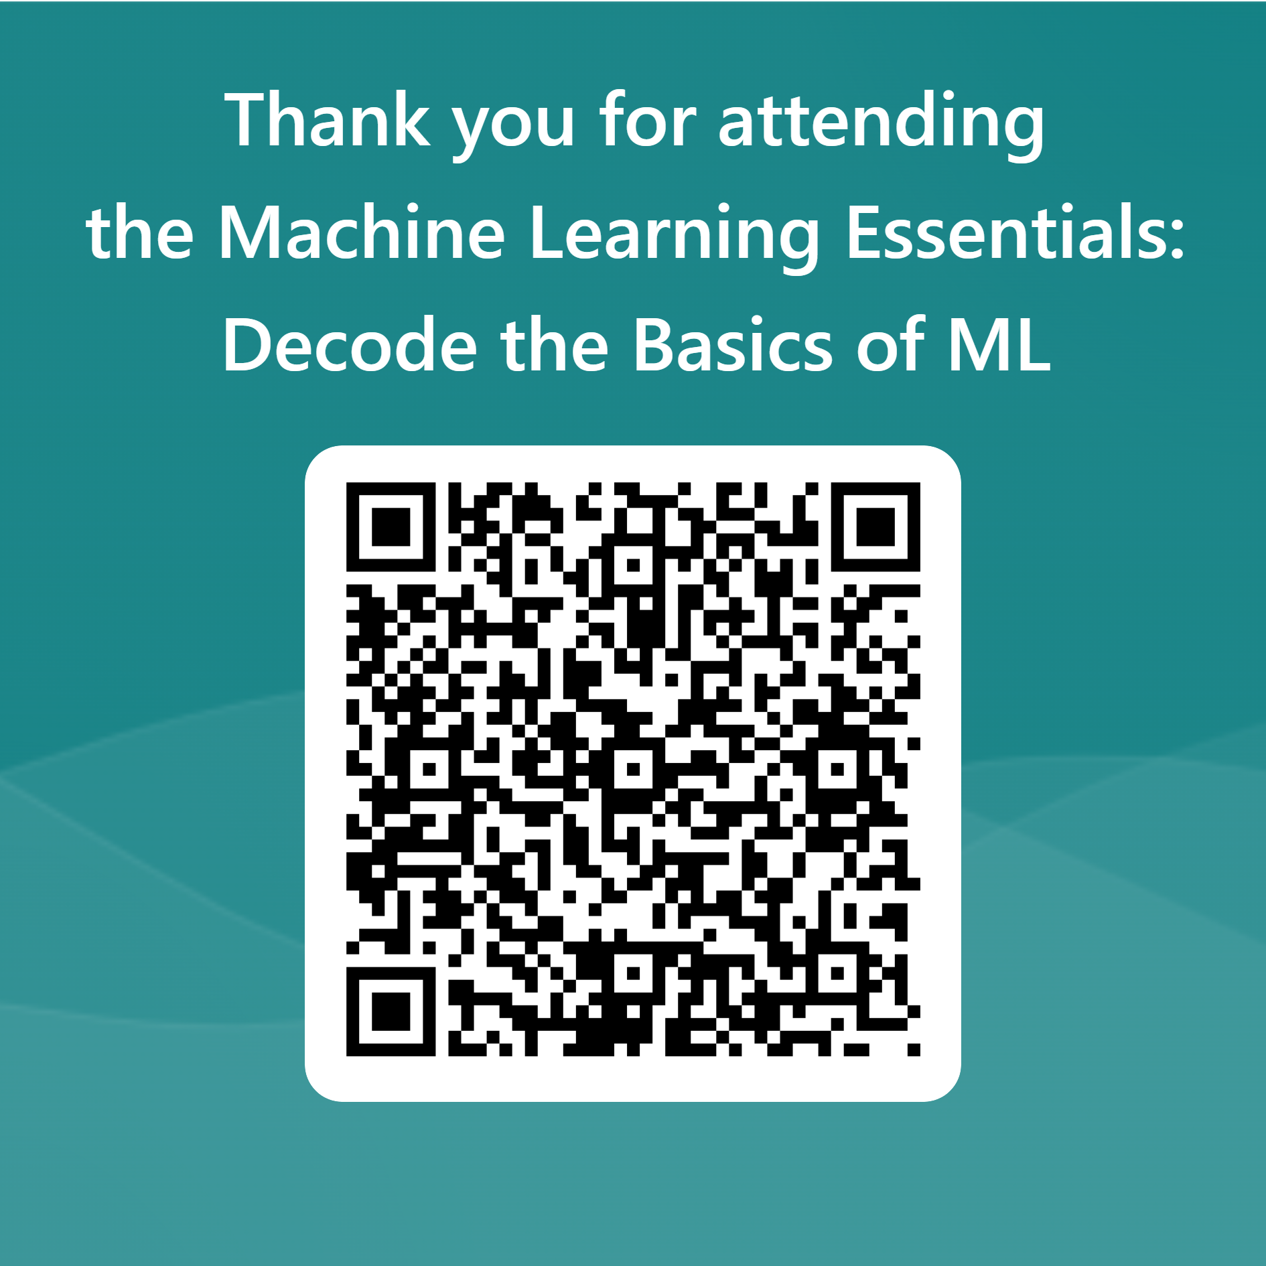
Feedback
https://github.com/ConnorUsaty/MacAIEducation2023
Star the repo so you can easily access it
Check it for updates and solutions to tutorial exercises

